Slide 1
Billionaires Statistics Analysis
Milestone 2 - Data Analysis and Predictive Modeling
Presented by: Kolusu Balaji

Slide 2
Overview
Description : This dataset contains statistics on the world's billionaires, including information about their businesses, industries, and personal details. It provides insights into the wealth distribution, business sectors, and demographics of billionaires worldwide.
Importance: This dataset serves as a valuable resource for researchers, economists, and business analysts to gain profound insights into global wealth distribution, economic trends, and the characteristics of the world's most affluent individuals. The potential use cases offer a diverse range of analyses that can contribute to a better understanding of wealth dynamics and socioeconomic factors influencing billionaires worldwide.

Slide 3
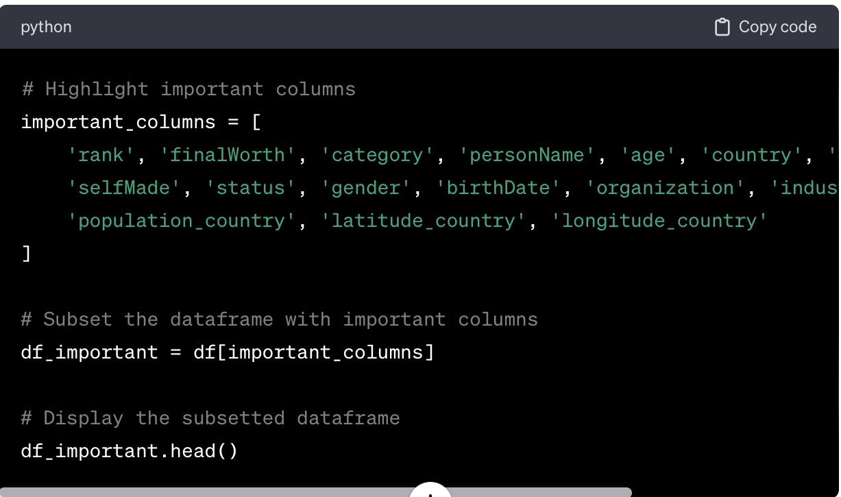
# Display the first few rows of the dataset df.head()
This code selects specific columns that are considered important based on the provided information and displays the subsetted dataframe. Adjust the list of important_columns as needed for the analysis.

Slide 4
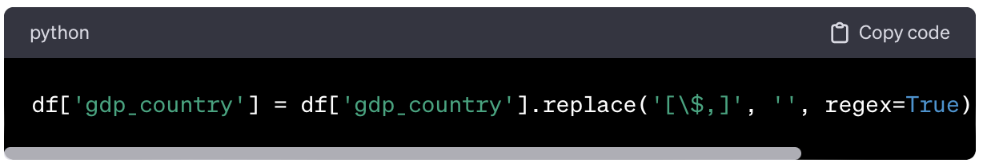
Handling Missing Values:
Purpose: This line of code is aimed at the 'gdp_country' column. It replaces any characters that represent currency symbols ('$') with an empty string, using regular expression ('[$,]'). Afterward, it converts the resulting values to float data type.

Slide 5
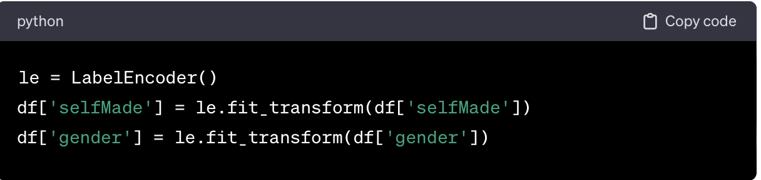
Label Encoding for Categorical Variables:
Purpose: This part of the code utilizes the LabelEncoder from scikit-learn to encode categorical variables into numerical format. It transforms the 'selfMade' and 'gender' columns into numerical representations.

Slide 6
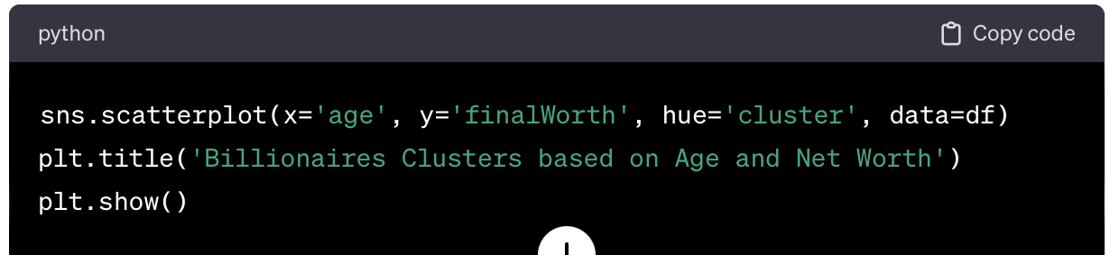
Initial Data Analysis
Scatter Plot for Clustering:
Purpose: This scatter plot visualizes clusters of billionaires based on their age and net worth. Each point represents a billionaire, colored according to the cluster they belong to. The purpose is to identify patterns or groups of billionaires with similar characteristics.

Slide 7
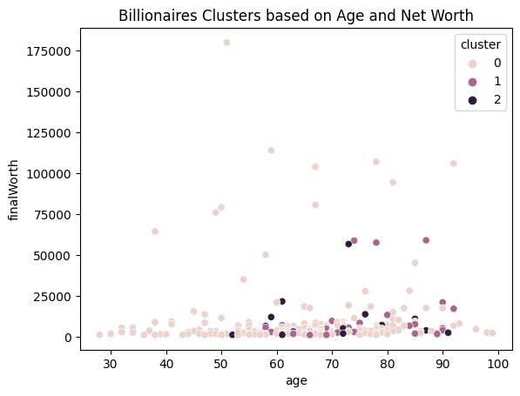
Visualization

Slide 8
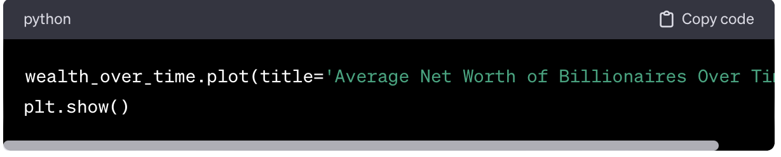
Line Chart for Trends Over Time:
Purpose: This line chart illustrates the average net worth of billionaires over time. By grouping the data based on the year, it helps to identify trends or patterns in the wealth accumulation of billionaires across different years.

Slide 9
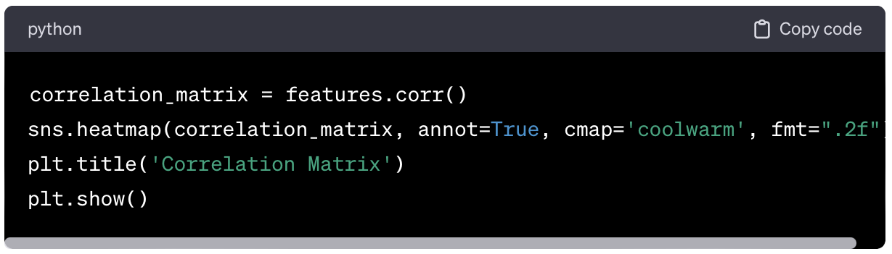
Heatmap for Correlation Matrix:
Purpose: The heatmap displays the correlation matrix of selected features (age, finalWorth, selfMade, gender, population_country, gdp_country). It helps identify relationships and correlations between these features. Strong correlations (positive or negative) are highlighted.

Slide 10
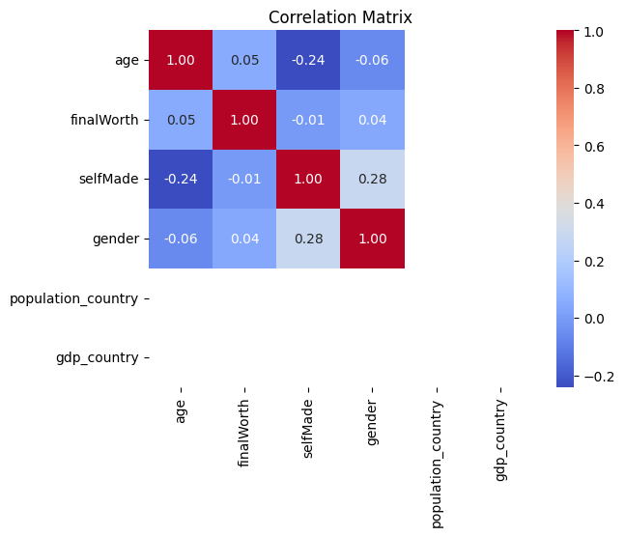
Visualization

Slide 11
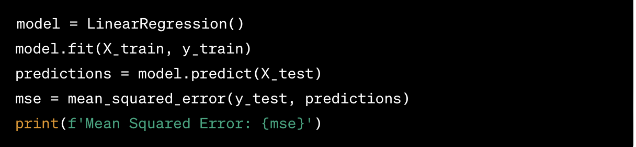
Linear Regression Model Evaluation:
Purpose: This part of the code builds a simple linear regression model to predict final net worth based on age. The Mean Squared Error (MSE) is calculated as a measure of how well the model performs. It helps in assessing the accuracy of the linear regression model.
Mean Squared Error: 300385817.05019385

